Slide 1
Automation Testing strategy

Slide 2

Automation defines how, when , why, who and where create test scripts
Why we automate
Higher return on investment(ROI)
Planned as team to reduce cost , effort and time
Deliver software faster
Improve QA process
Handle allots of data and repetitive task
Customer fast release with hotfixes

Slide 3

Feasibility Analysis
Determine which tasks can be automated and which testing scenario you should not automate.
We can consider the following aspects to automate :
Repetitive test cases such as login and entering OTPs, captcha.
Process working on multiple inputs, such as filling forms to test validations
Tasks that are time-consuming and difficult to test manually.
Cross browser testing
Find, communicate, and audit the risks, defects, and even the capabilities of the software being tested
Prioritize the components

Slide 4

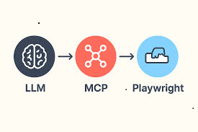
Who automate and selection of tool
Manual tester
Automation engineer
Mixture
Go with +1 sprint strategy for automation
Above all MCP server, AI Agents, Langchain reduce cost and effort to maintain automation test
Playwright
Cypress
Selenium
Appium
XcuiTest
RestAssured
Karate
Postman
Jmeter
Gatling
Testim

Slide 5
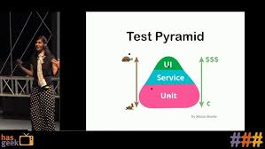
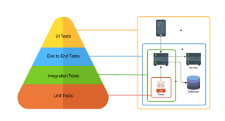
Types/Level of testing
Coverage/Techniques/Types of testing
1.Equilvalence Class Portioning
2. Boundary value analyses
3.State Transitions
1.Functional
2.Non functional
Unit testing
Component testing
Integration testing
System testing
Acceptance testing
Alpha Testing
Beta Testing

Slide 6
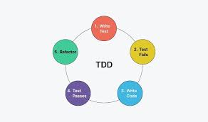
Test Design and execution
Prioritize the test and designed accordingly
Execute test scripts
Traceability matrixes
Test coverage
Defect Leakage
Flaky Tests
Test wear out
Improvements and keep update with test scripts
Clean code use Sonar Cube

Slide 7
Test Environments
DEV
QA
Stage
Production
hardware or basic software set-ups
Setup of drivers
Network connections

Slide 8
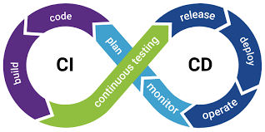
Release Control & CI/CD
proper history of the testing process
authorities and teams responsible in every case
components subjugated to the test
defects encountered for the first time
version and highlighting the changes chronologically is the most crucial
Run tests automatically on Jenkins, GitHub Actions, or GitLab pipelines.
Trigger Points
Stages in CD
1. Deploy Build to Environment
QA → Staging → Production

Slide 9
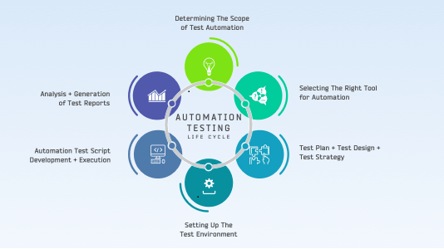
key elements to an effective test automation strategy

Slide 10





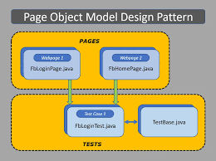



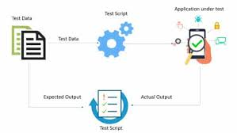

Critical thinking make tester life easier
Tools
Framework
Manual Trigger
Local runs
Cloud services
Grid
CI/CD
Databases

Slide 11
Risk and Maintenance
Analyze test-level risks for the organization & stakeholders to make informed decision
Regression averse strategy prominently focuses on eliminating the risks of regression in the project
developed testware can be re-used or periodically changed per the project requirements
Product and failure risks involved with the system under test play a critical role in identifying the dimensions of the strategy
Spending too much time testing components with little or no risk or bug likelihood is not the right approach
Weekly
Fix locators
Update flaky tests
Clean old data
Sprint-based
Add new test cases
Update POM
Add new utilities
Monthly
Update Tool
Research on New AI and automation tool
Optimize CI time
Remove deprecated code

Slide 12
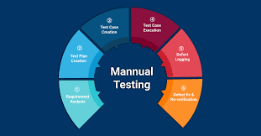
Manual Testing Approach
Follow a –1 Sprint Automation Strategy
Write detailed manual test cases for all sprint user stories
Execute tests as soon as development completes each feature
Perform iterative testing throughout the sprint (build-by-build)
Log and track defects early, retest continuously
Conduct exploratory testing for edge cases and negative scenarios
Collaborate closely with developers for fast feedback
Shift left testing
Use last 2 days of the sprint for full regression
Validate:
Critical flows (login, checkout, dashboard, etc.)
Integration between new & existing features
Ensure product stability before release
Confirm readiness for stakeholders & customers
User AI tools that helps and facilitates to achieve your testing goals of sprint

Slide 13


